Slide 1
PARLIAMO DELL’UZBEKISTAN: Progetti, investimenti, prospettive
Luigi Iperti
Presidente CIUZ- Camera di Commercio Italia Uzbekistan
29 giugno 2017, Milano

Slide 2
Andrea Bocelli
June, 8° 2017
First concert in Uzbekistan for the legendary Italian tenor, Andrea Bocelli
The event was supported by the Uzbek Ministry of Culture

Slide 3
Uzbekistan

Slide 4
Italia - Uzbekistan
Distanza 4.630 Km

Slide 5
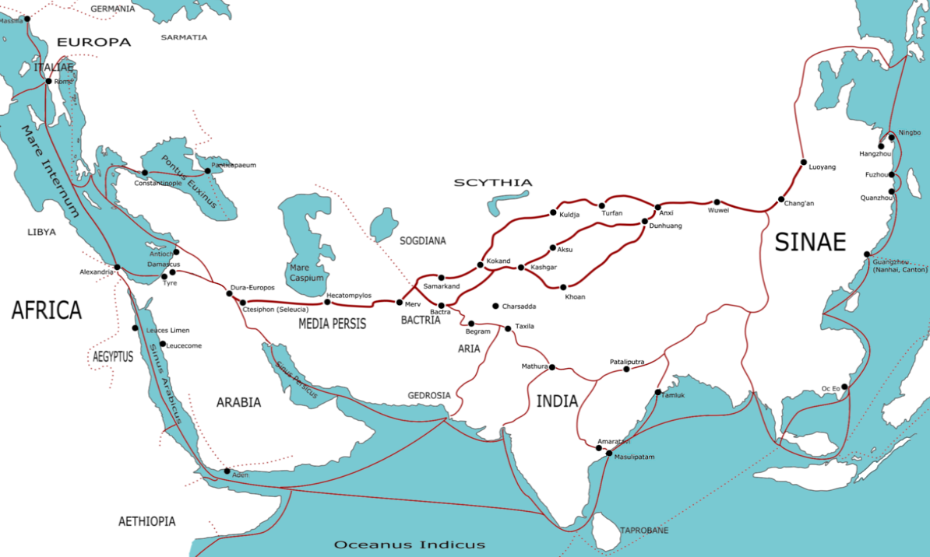
The silk road

Slide 6
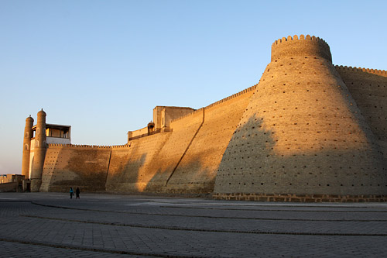
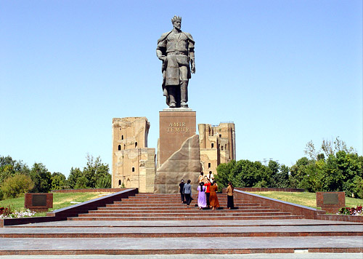
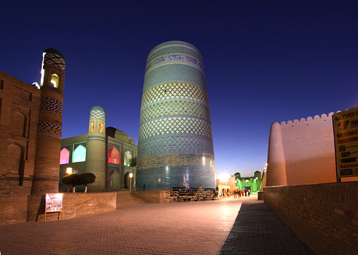
UNESCO World Heritage list Cities

Slide 13
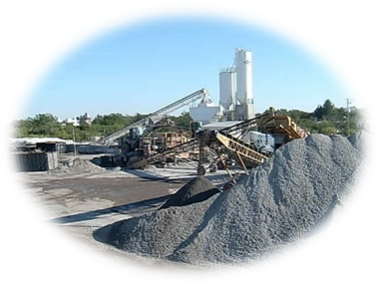
Factors of success in Uzbekistan
1. Political & macroeconomic stability
2. Sound legal base
3. Rich raw material base
4. Diversified industrial base
5. Advantageous geographical location
6. Well educated human resources

Slide 14
Uzbekistan in numbers
Population: 31 millions
Automotive production: 280.000 cars/year
Agroindustry development: cotton 3,4 Mio/ton
Gas production: 60 BCM/year

Slide 15
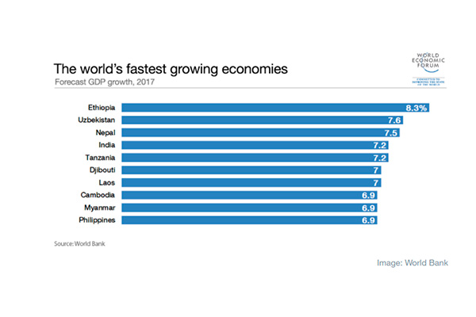
World Economic Forum.
The World Economic Forum published the list of the world’s fastest growing economies
based on the World Bank’s report “Global Economic Perspectives”.
Uzbekistan was included to the top 10 of the fastest growing economies of the world.
The growth of Uzbekistan’s economy forecasted at 7.6% in 2017.
This is the second result after Ethiopia, economy of which is expected to grow by 8.3%
in 2017

Slide 16
Gross domestic product (GDP)
World Bank improved its forecast for economic growth of Uzbekistan.
According to the bank’s forecasts, the growth of Uzbekistan’s economy will make:
7.6% in 2017
7.7% in 2018
7.8% in 2019
The bank’s report noted that Uzbekistan’s GDP increased by 7.8% in 2016,
which is 0.5 percentage points higher than the January forecast.

Slide 17
Macroeconomic stability and dynamic industrial policy
GDP growth rate (in % to previous year)
GDP has increased 4.1 times during the years of independence;
Sustainable high rates of economic growth retain at the level not less than 8% annually for the last years;
Industrial production growth rate
(in % to previous year)
The volume of industrial output increased 3.7 times for the years of 1990-2013;
Average annual growth rate of industrial output has compounded 9.4% for the last 10 years, exceeding GDP growth rates.

Slide 18
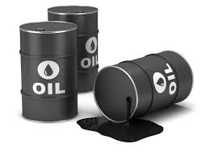
BP - World Energy 2016
Proved oil reserves in Uzbekistan estimated at the volume of 0.6 billion barrels
in 2016, according British Petroleum (BP) in its Statistical Review of World Energy 2016.
Uzbekistan possesses 1.1 trillion cubic meters of proved natural gas reserves at the end 2016.
The share of Uzbekistan in world reserves is 0.6%.
Uzbekistan produced 2.6 million tonnes of oil in 2016, which fell by 3.1% compared to 2015.
Uzbekistan produced 55,000 barrels of oil per day in 2016 (-3.1%).
Uzbekistan’s oil consumption grew by 0.7% to 2.8 million tonnes in 2016.
Average daily oil consumption made up 59,000 barrels in 2016.
The throughput of oil refineries grew by 11.5% in 2016 compared to 2015 –
up to 70,000 barrels a day.

Slide 19
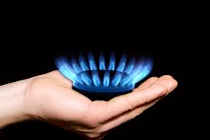
BP - World Energy 2016
Uzbekistan produced 62.8 billion cubic meters of gas in 2016, which is 8.4% more than in 2015 (57.7 billion cubic meters of gas).
Gas consumption in Uzbekistan made up 51.4 billion cubic meters in 2016, which is 2% more than in 2015.
Energy consumption in Uzbekistan in 2016 increased to 52.7 million tonnes of oil equivalent from 51.7 million tonnes in 2015.
Coal reserves in Uzbekistan exceeded 1.37 billion tonnes in 2016, BP said. Last year, Uzbekistan produced 1.1 million tons of coal.
The electricity generation capacity in Uzbekistan increased by 1.9% in 2016 compared to 2015 - up to 58.9 terawatt-hours.
The volume of carbon dioxide emissions in Uzbekistan stood at 117 million tonnes in 2016, which is 1.4% higher than in 2015.

Slide 21
Foreign enterprises in Uzbekistan
CNPC
over 4850 enterprises with foreign capital

Slide 22
Share of economic sectors in GDP (%)

Slide 23
Share of small business in GDP and industry (%)

Slide 24
Program for Expansion of the private sector’s share in the economy
Agro-Industrial Sphere (1)
Oil and Natural Gas Sphere (16)
Foreign Trade Sphere (2)
Light Industry (2)
STOCKS AND SHARES IN
68 LARGE ENTRPRISES
Chemical Industry (4)
Transports Sphere (3)
Printing Industry (1)
Food Production (15)
Electrical Engineering (4)
Branch of Construction (5)
Financial Institutions (4)
Winery Plants (2)
Enterprises of Other Spheres (8)
Automobile Industry (1)

Slide 25
Strong collaboration
Italian
PMI
Uzbek
PMI

Slide 26
Turin Polytechnic University in Tashkent
Established on April 27, 2009 under the decree of the President of the Republic of Uzbekistan №1106
2016: 700 students
FACULTIES:
mechanical engineering;
power engineering;
civil engineering & architecture

Slide 27
Cooperation between Uzbekistan and Italy in trade and economic sphere (€ Mln.)
STRUCTURE OF EXPORT: textile, thread, cotton, dried fruit.
LIST OF IMPORT: electric and mechanic equipment, automobile spare parts, plastic materials, pharmaceutical and construction materials.
Source: Info Mercati Esteri

Slide 28
Free industrial economic zone “Navoi” degree of the President of the Republic of Uzbekistan December 2, 2008
Territory - 564 ha
Distance between Navoi
Tashkent – 490 km
Samarkand – 153 km
Bukhara – 110 km

Slide 29
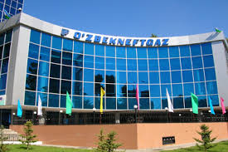
Uzbekneftegaz
Uzbekneftegaz will complete 16 investment projects in 2017
According to the investment programmed for 2017, Uzbekneftegaz with foreign partners
is working on implementation of 50 investment projects.
Total cost of the projects is over US$ 21.88 billion.
In 2017, the volume of investments will be US$ 2.95 billion.
Uzbekneftegaz is implementing projects on construction of the Kandym gas processing plant,
the Jizzakh oil refinery, development and construction of the geochemical complex based on
the field “Mustaqillikning 25 yilligi”.

Slide 30
Gas to China
Uzbekneftegaz will increase the volume of the gas supplies to 10 billion cubic meters a year
in 2018-2020.
Uzbekistan and Turkmenistan supply to China gas through the Central Asia-China gas pipeline
with the capacity of 50 billion cubic meters a year.
The pipeline has three lines now.
Gazprom
In 5 April 2017 Uzbekneftegaz signed a contract for purchase of 4 billion cubic meters of gas
a year by Gazprom for a period of up to five years, starting from 2018.
In April 2017, the sides concluded an agreement on joint exploration and engineering and
innovation works.
Gazprom purchased about 6.2 billion cubic meters of gas from Uzbekistan in 2016.

Slide 31
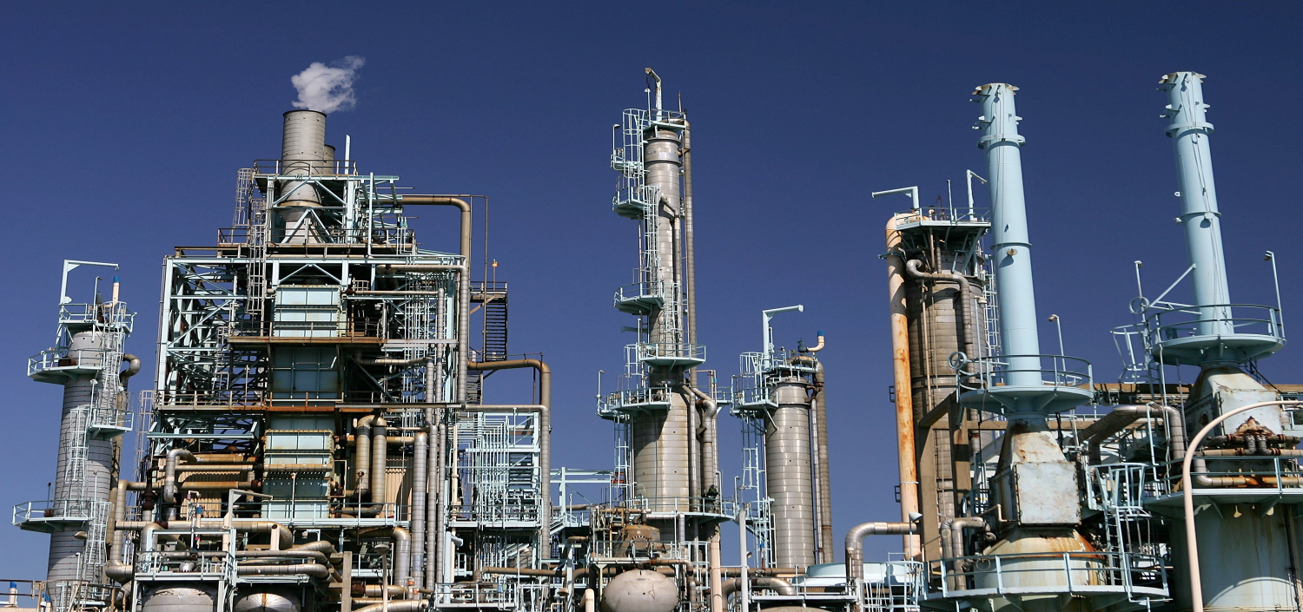
Oil refinery complex in Jizzakh region.
Uzbekistan started construction of a 5.0 MM tons refinery.
The state-run project in the Jizzakh region bordering oil-rich Kazakhstan will receive crude through a pipeline to be built from Russia through Kazakhstan.
The Jizzakh refinery will produce more than 3.7 MM tons of gasoline, more than 700,000 tons of jet fuel and about 300,000 tons of other oil products annually, to be sold both domestically and abroad.

Slide 32
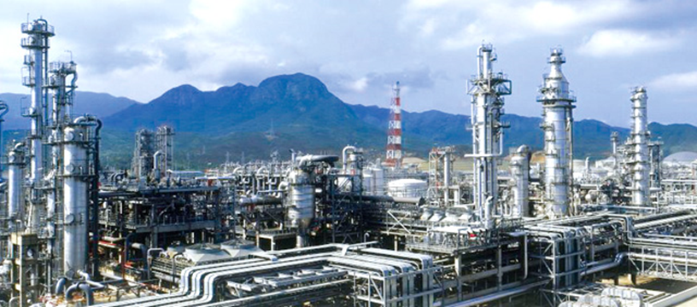
Gas-to-liquids (GTL) project in Uzbekistan. Value: 3.5 bn USD. Project on hold
The construction contract was awarded to Hyundai. The plant will be located 40 km south of Qarshi.
This plant will be based on Sasol’s GTL technology and will have a capacity of 1.4 million metric tons
per year, with following products:GTL diesel, kerosene, naphtha and liquid petroleum gas.
The front-end engineering activities was executed by Technip’s operating center in Rome.

Slide 33
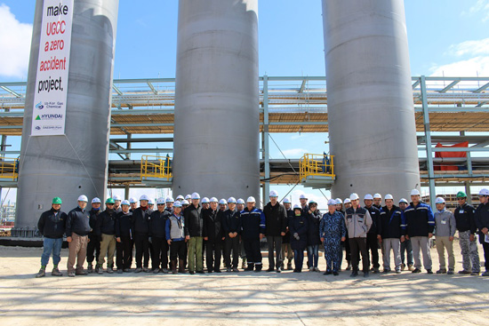
Ustyurt Gas Chemical Complex (GCC) in
Kungrad: joint project with South
Korean partners for Uz-Kor Gas Chemical JV
4.5 BCM of gas per year;
400,000 tons of high density polyethylene;
100,000 tons of polypropylene, tank gas, distillate pyrolysis and pyrolysis oil;
total cost $3.9 billion;
direct investments of South Korean companies.

Slide 34
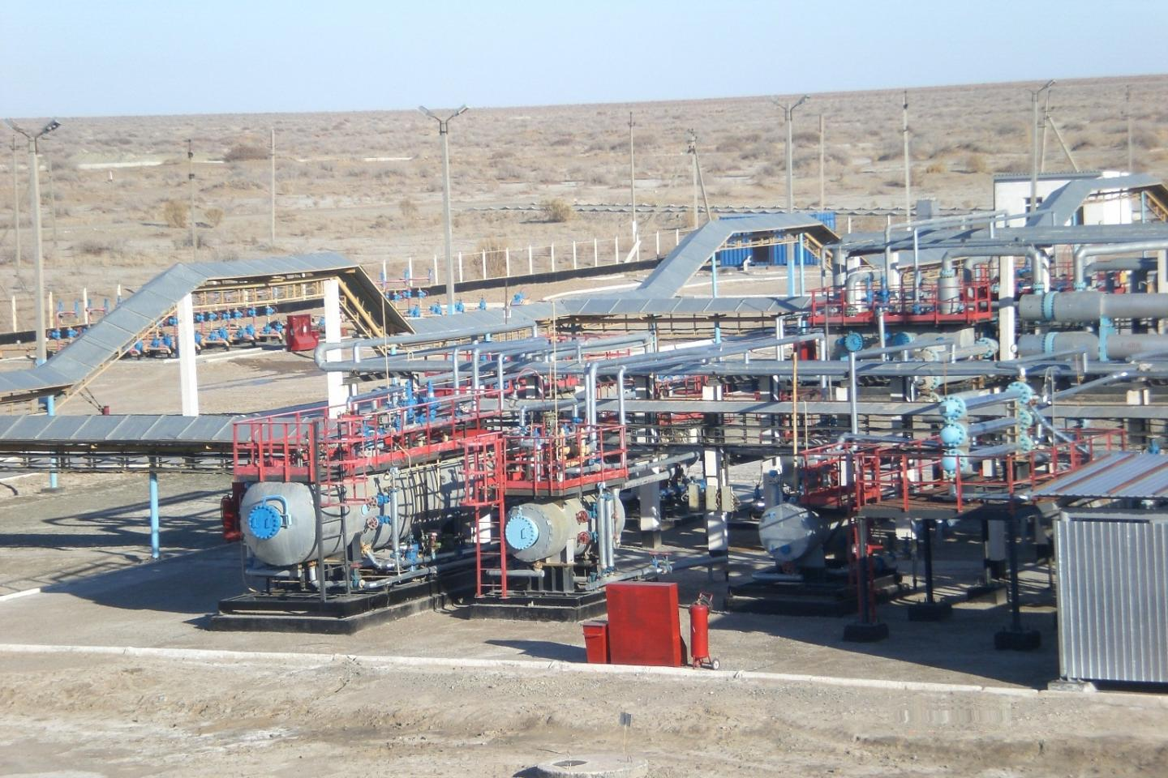
Construction of a new plant for hydrocarbons pyrolysis for Uz-Kor Gas Chemical JV
Value: $300 million
Timeframe: 2017-2019

Slide 35
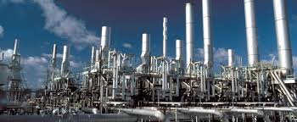
Enhancing the production capacity of the Shurtan Gas Chemical Complex
Value: $570 million
Timeframe: 2016-2019
The Shurtan Gas Chemical Complex already processes 3.9 BCM of gas each year, and this will be extended further with a $570 million project to enhance capacity.

Slide 36
Modernization of the Bukhara Oil Refinery
Value: $348 million;
Timeframe: 2019-2021;
Modernization of the Bukhara oil refinery will begin in 2019 to bring its production capacity to 2.5 million tons per year.

Slide 37
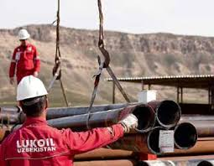
LUKOIL
Lukoil has been actively involved in major projects in Uzbekistan. The on-going projects entered within the frame of agreements on extraction of gas, gas condensate and oil fields signed in 2004.
Lukoil is investing over $ 5 million in two PSA gas projects in Uzbekistan
Kandym-Khauzak-Shady. The design capacity will be 8 bcm of gas per year.
South-West Gissar. Start-up of new facilities is scheduled for beginning of 2017, investments will exceed 1 billion US dollars, gas production is 4.8 bcm annually.

Slide 38
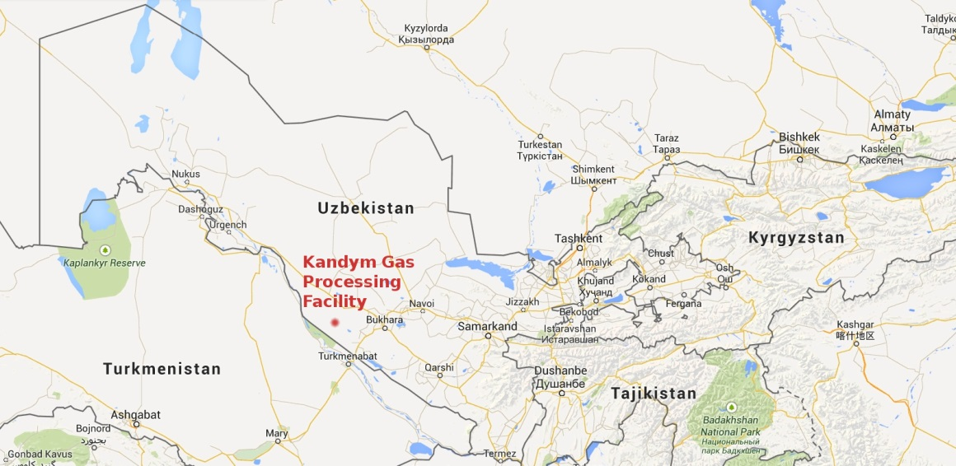
Lukoil : Construction of a gas processing plant at the Kandym field group deposits
Value: $2.66 billion
Timeframe: 2015-2019
Entirely funded by Lukoil, this project involves construction of a gas processing plant
fed by deposits at the Kandym, Khauzak, Shady and Kungrad fields. Once completed
in 2019, this project will add an annual production and processing capacity of 8.1
BCM of natural gas.Construction hardware will be supplied by the South Korean
Hyundai Engineering.

Slide 39
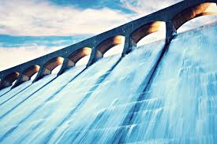
Hydropower sector. Uzbekhydroenergo.
Uzbekhydroenergo will implement a unified technical policy in the field of electric
power production at hydroelectric power stations.
Uzbekistan will direct US$2.65 billion for development of hydropower sector in
2017-2021 according President Shavkat Mirziyoyev decree.
Within the framework of the program, Uzbekistan plans to implement 18
construction projects and 14 projects for modernization of hydroelectric power
stations with total cost of US$ 2.65 billion.

Slide 40
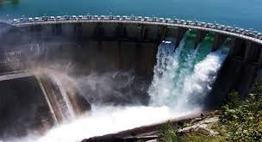
Hydropower sector. Uzbekhydroenergo.
The program of measures for the further development of hydropower also
includes 42 promising projects with an approximate cost of about US$ 1.7 billion.
These projects will be implemented by 2030.
Uzbekistan will use US$1.64 billion of its own funds for implementation of the
program. The Country will also attract US$1.009 billion funds of international
and foreign financial institutions.
Implementation of the program will allow Uzbekistan to increase the capacity of
hydroelectric power stations by 1.7 times to 3,038 MW by 2026. As a result, the
share of hydropower in the structure of generating capacities will increase from
12.7% to 15.8%

Slide 41
Renewable energy
Uzbek President Shavkat Mirziyoyev approved targeted parameters on further
development of renewable energy.
The purpose is to increase share of renewable energy in structure of generating
capacities from 12.7% to 19.7% by 2025, including:
- hydro power from 12.7% to 15.8%,
- solar energy to 2.3%
- wind energy to 1.6%.

Slide 42
Renewable energy
The President of Uzbekistan approved implementation of 810 projects for
development of renewable energy for a total sum of US$ 5.3 billion in 2017-2025.
Moreover:
It is planned to replace 17,250 heating boilers in 6,330 organizations of the
Ministry of Public Education, Healthcare and Center for secondary and professional
education.
In 2017-2021, Uzbekistan will replace 879 pumps and 1,523 electric motors in
water management organizations. This will save 807.3 million kilowatt-hours of
electricity.

Slide 43
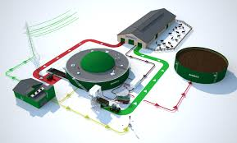
Biogas plants
Uzbekistan plans to install biogas plants at 726 large livestock and poultry farms by 2020.
According to the program, biogas plants will be installed at 75 large livestock and poultry
farms in 2017, 291 in 2018 and 360 in 2019.
The Country started production of biogas plants at 8 domestic enterprises, including on
the basis of Oil and Gas and Chemical Engineering Plant.
The resolution underlined that Uzbekneftegaz, Agrobank and Poly International Holding
(China) signed a memorandum on cooperation in organization of joint production of modern
biogas plants worth US$10 million.
Currently, biogas plants have been installed in 45 livestock and poultry farms of Uzbekistan
with a total annual capacity of 1.1 million cubic meters of biogas.

Slide 44
Uzavtosanoat
Uzbek Automobile Industry ( Uzavtosanoat) will implement 51 projects for US$ 834.9 million in 2017-2021(Jun 16, 2017)
It is expected that Uzbekistan will produce 122,000 cars in 2017.
Uzbekistan plans to increase production of cars from 88,200 in 2016
to 240,000 in 2021.

Slide 45
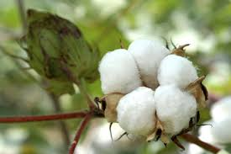
Textile protocol
Senate of Oliy Majlis of Uzbekistan ratified the inclusion of the "textile protocol"
to the agreement on partnership and cooperation between the EU and Uzbekistan.
This document will make it possible to introduce the most-favored-nation treatment for textiles from Uzbekistan.
The document is aimed at reducing duties on import of textiles from Uzbekistan, which will facilitate the trade in cotton and textile products between Uzbekistan and the EU.
On Sept. 13-15, Tashkent will host the 14th edition of the exhibition CAITME and Textile Expo Uzbekistan: Italian stand by ICE and ACIMIT.
More than 6000 visitors in the last edition

Slide 46
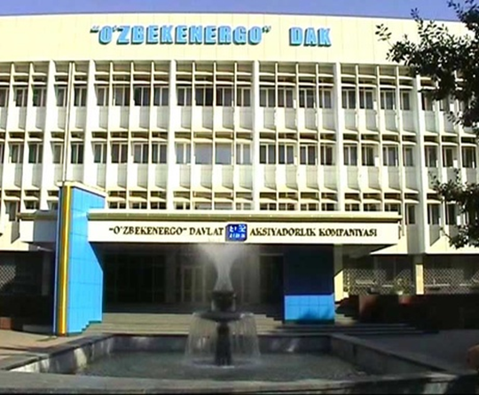
UZBEKENERGO
The Power Industry of Uzbekistan operates in the framework of the State Joint Stock Company ”Uzbekenergo”. The company structure includes 53 enterprises and organizations, 39 open joint-stock companies, 11 unitary enterprises.
As for now, the company performs the centralized electric power supply to national economy and population, and also sale of thermal energy to industrial and domestic consumers.
UZBEKENERGO will invest in 2017 about 600 MIO USD

Slide 47
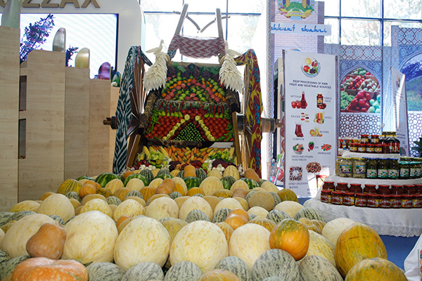
Fruits and vegetables
Uzbekistan exported to Russia, in 2016, up to 1 million tons of agriculture products
Supply of fruits and vegetables to Russia makes up 60-65% of total exports of Uzbekistan.
Uzbekistan plans to export 560,000 tons of fruits and vegetables for US$410 million to Kazakhstan in 2017.
Uzagroexport exported 101,800 tons of fruits and vegetables in the first quarter of 2017.
Uzbekistan exports fruits, vegetables and processed products to over 50 Countries of the world.
In the first 3 months of 2017, the hard currency revenue made up US$129.3 million from export fruits and vegetables.

Slide 48
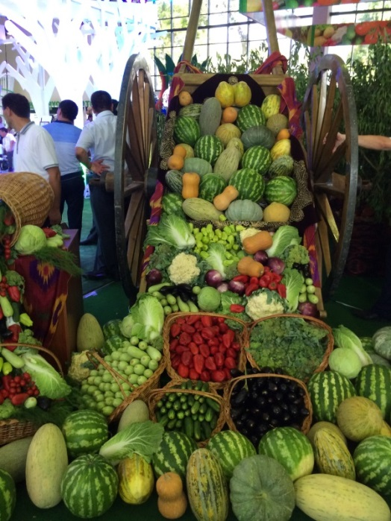
Fruits and vegetables
Number of exporting enterprises rose from 147 in 2015 to 298 in 2016, while
14 new enterprises started to export their products in the first quarter of 2017.
Will be created a new logistics center in Shakhrisabz city to organize export of fruits and vegetables.
The logistics center will specialize in receiving, sorting and processing fruits and vegetables,
carrying out laboratory analysis.
on the level of world standards, packaging as well as exporting them fresh, cooled and dried forms.
After launch of the center, it will annually export 25,000 tons of products to Europe, CIS, China,
India, South Korea and other states.

Slide 49
Other Projects
Uzbekistan will implement 1,948 projects of localization for 2010-2019
they helped to produce import-replacing products for US$7.6 billion
The production of localized products in Uzbekistan will rose by 3 times.
This helped to create over 13,000 new jobs.

Slide 50
International Exhibition Oil and Gas Uzbekistan OGU 2018 (17-19 May)
Opened at the UzExpoCenter National ExpositionCentre.
It is organized by Uzbekneftegaz national holding company, the Ministry of
Foreign Economic Relations, Investments and Trade of Uzbekistan,
Chamber of Commerce and Industry of the Republic of Uzbekistan.
CIUZ will attend hosting Italian companies with the brand “Technology of Italy” .

Slide 51
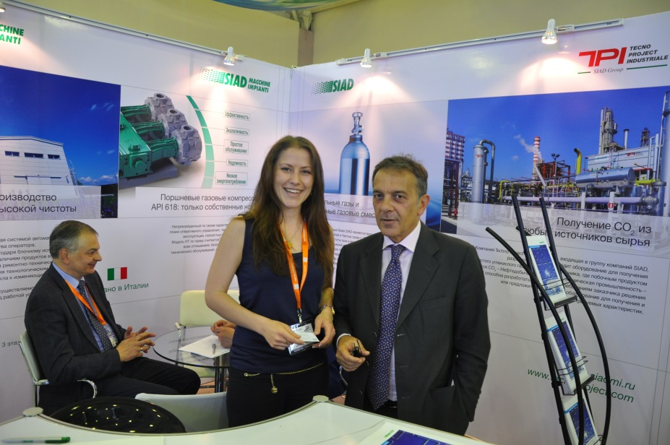
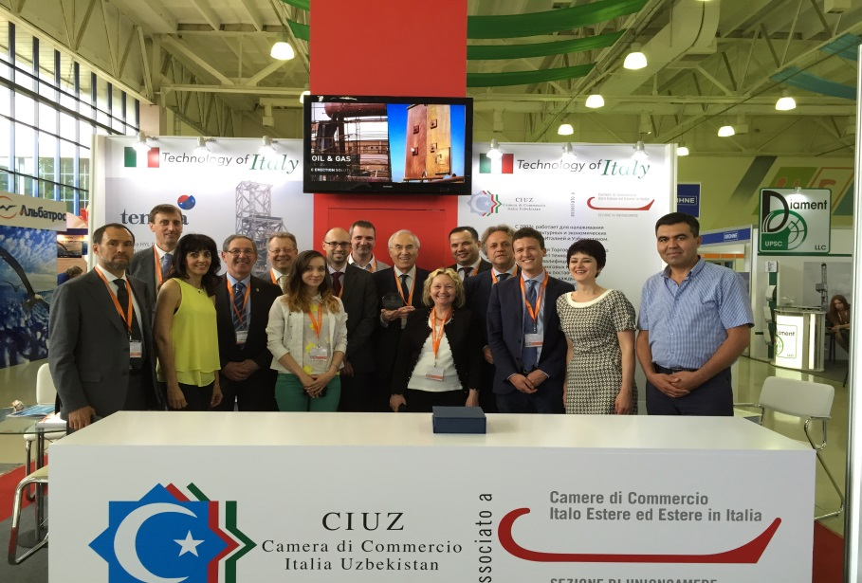
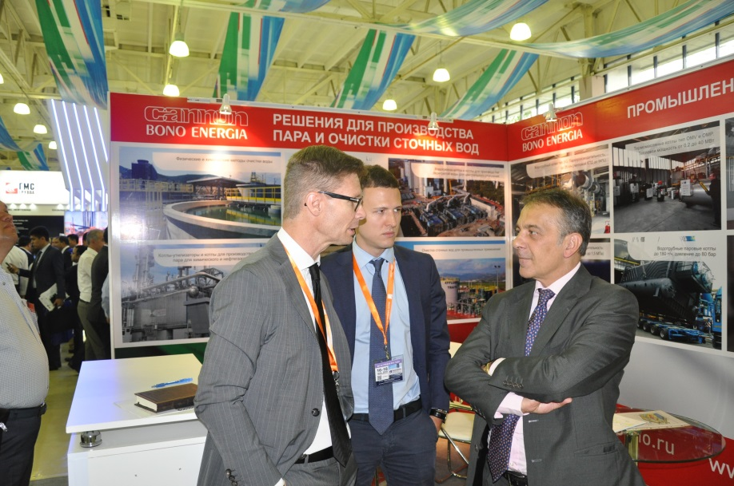
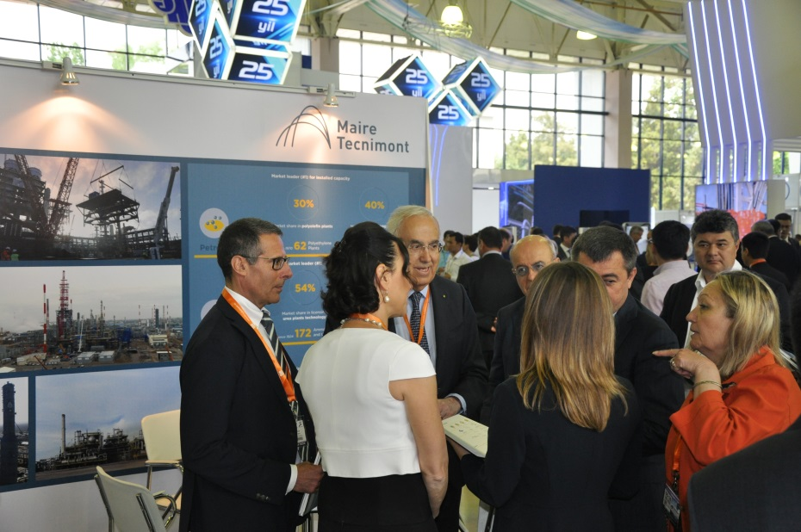
Edition 2016/17

Slide 52
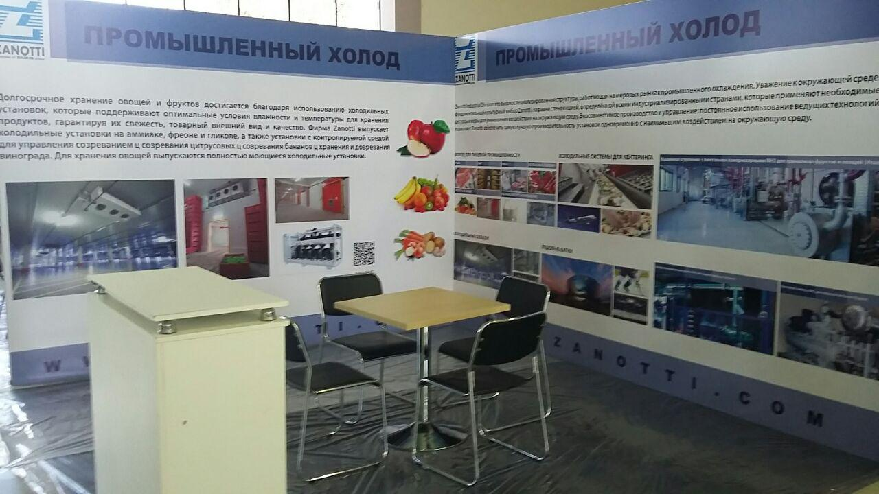
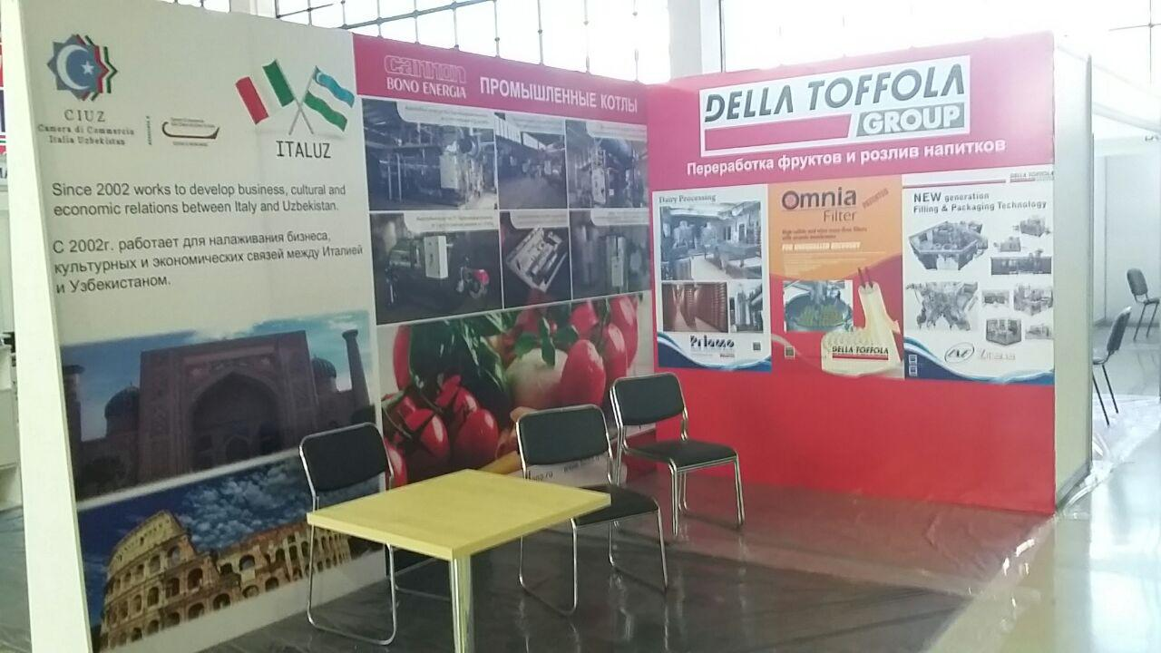
World Food Uzbekistan, 29 – 31 March 2017
food products
food ingredients, additives, spices
equipment for food industry
packaging

Slide 53
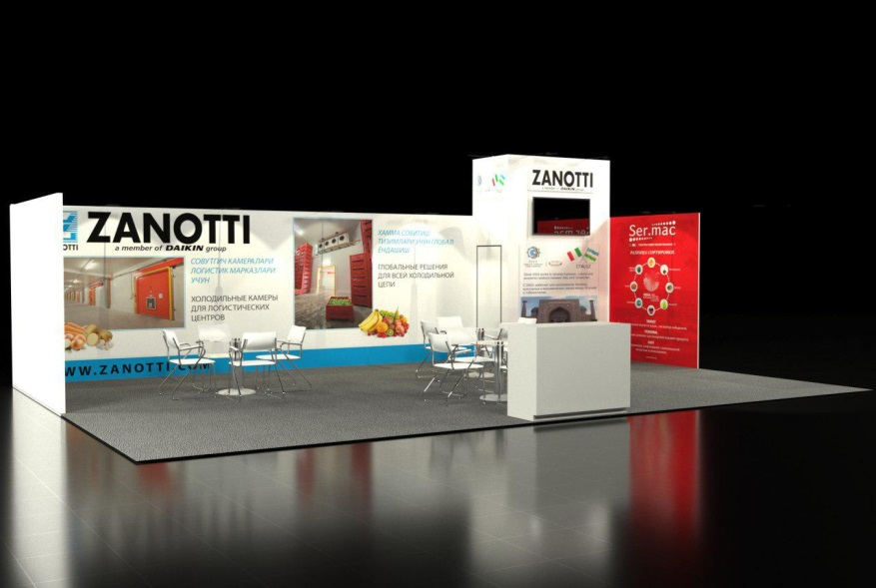
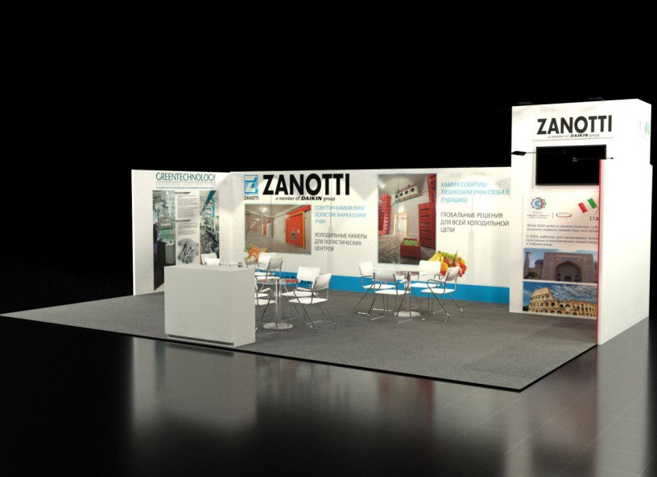
Uzbekistan AgroTech AgroMash Expo
30 May- 02 June 2017
Important exposition dedicated to agro industrial machinery and technology, food processing, agricultural machinery, fruit and vegetable processing, packaging and labeling, milk processing, biotechnology industries.
Expositors: > 240
Countries: > 30
Visitors: > 40,000
Organized by : Ministry of Foreign Economic Relations

Slide 54
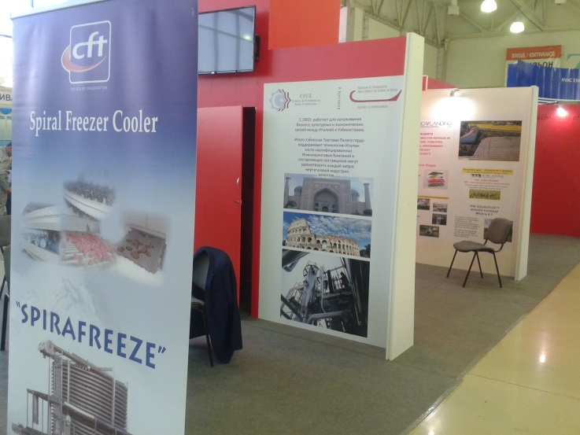
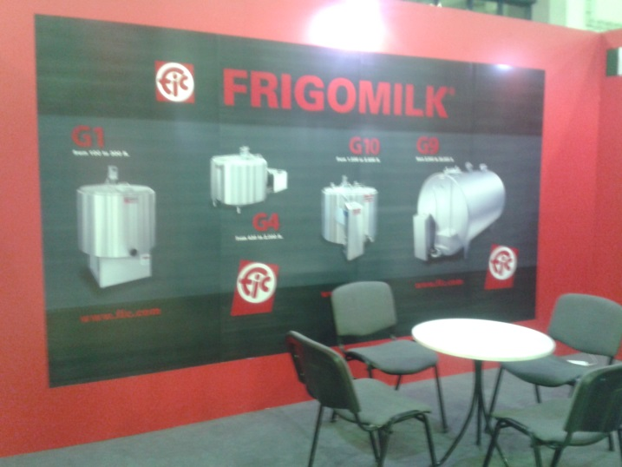
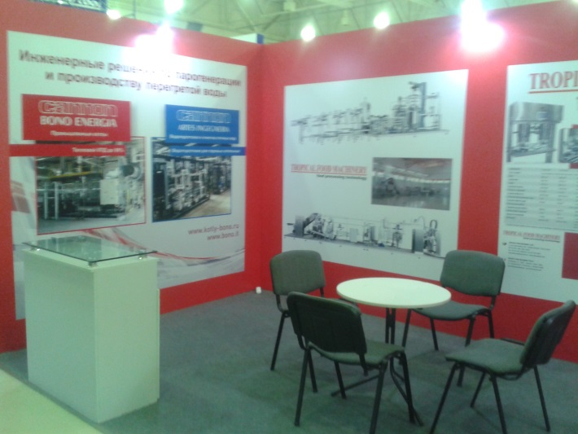
Edition 2015

Slide 55
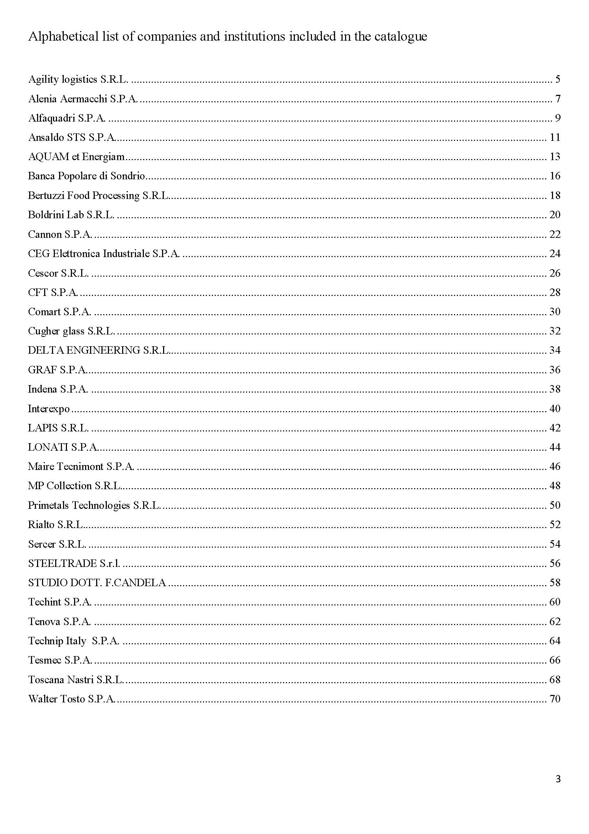

Slide 56
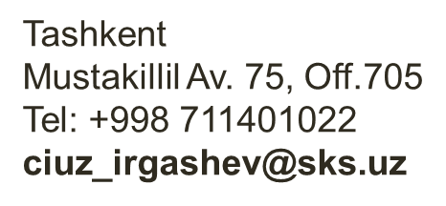
Comitato imprenditoriale dei due Paesi
La Camera di Commercio Italia Uzbekistan con uffici a Tashkent ed a Milano.
www.ciuz.info

Slide 57
Grazie per la cortese attenzione
Luigi Iperti
Presidente CIUZ- Camera di Commercio Italia Uzbekistan

