Slide 1
UZBEKISTAN:
Un fiorente mercato per l’Italia.
Opportunità per esportazioni ed investimenti italiani.
Milano, 11 giugno 2015
Palazzo Turati- sala Consiglio
Luigi Iperti
Presidente CIUZ - Camera di Commercio Italia Uzbekistan
Notes:
I have been visiting this Country for many years and every time I come back, I notice just how much it has progressed. Now development has speeded up, along lines which I share. For example, I notice an increasing amount of cooperation with a growing number of other countries including, I am pleased to see Italy which could become very useful partner for the technological and industrial growth of Uzbekistan.
It is the Italy Uzbekistan Chamber of Commerce’s duty to help and promote relations between our two countries. On the basis of the programs of the Uzbek Government, we must ensure the businessperson of both countries to cooperate so these programs are implemented to the best possible way.
Today, we are here for this Conference and we want to explore how our actions can take concrete shape in the gas industry.

Slide 2
Management Training Programme (MTP) - Capacity Building for SME Management in Uzbekistan
UZBEKISTAN:
Un fiorente mercato per l’Italia.
Opportunità per esportazioni ed investimenti italiani.
Programma di training,
finanziato dall’UNIONE EUROPEA,
per le PMI dell’Uzbekistan.
11 giugno 2015, h 14,00
SALA CONSIGLIO, Palazzo Turati (Milano, via Meravigli 9/b)
INGRESSO LIBERO CON PRENOTAZIONE

Slide 3
Management Training Programme (MTP) - Capacity Building for SME Management in Uzbekistan
INTERVERRANNO:
S.E. Ravshan Usmanov, Ambasciatore della Repubblica dell’Uzbekistan
L’Uzbekistan un Paese stabile in forte sviluppo
Ing. Luigi Iperti, Presidente della Camera di Commercio Italia Uzbekistan:
Le prospettive per le esportazioni italiane
Mr. Oleg Rijichenko, Head of Business Development della Camera di Commercio e Industria dell’Uzbekistan:
Business opportunities for Italian companies
in Uzbekistan;
Dr. Alisher Juraev, Senior Advisor del "Management Training Program (MTP) - Capacity Building for SME management in Uzbekistan"
Project: Establishing cooperation between Italian and Uzbek companies through MTP internships program;
Mr. Otabek Saidov, Fondatore e direttore della società "Chrichiq Komunal Servis" (Manufacturer of domestic and industrial boilers):
About the company and proposal for establishment of joint venture in Uzbekistan.

Slide 4
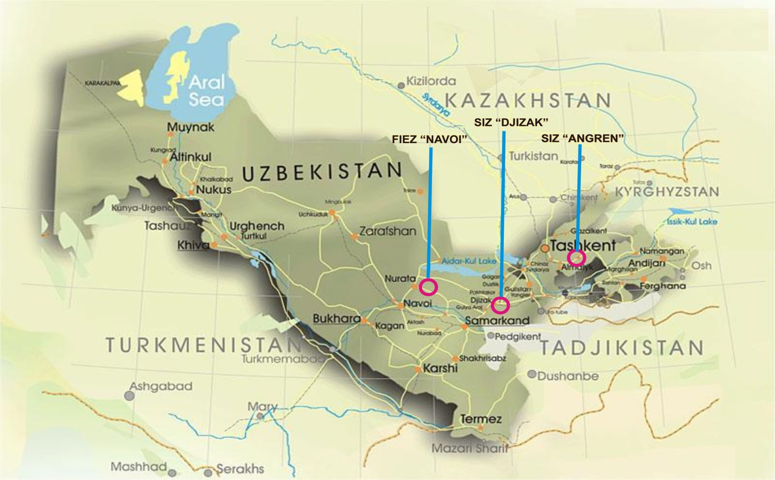
Uzbekistan
Notes:
4

Slide 5
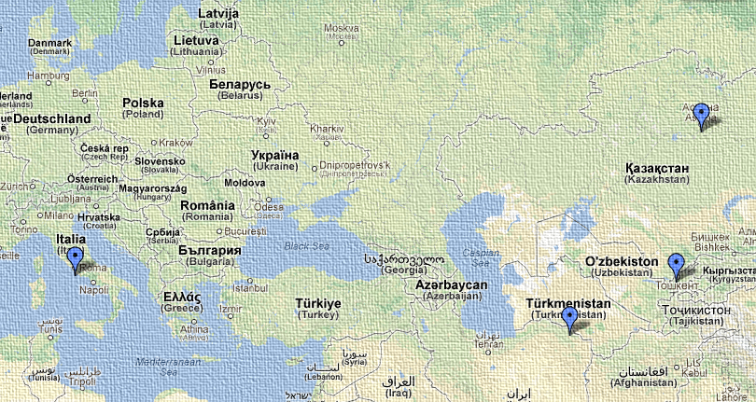
Italia Uzbekistan
Distanza 4.630 Km

Slide 6
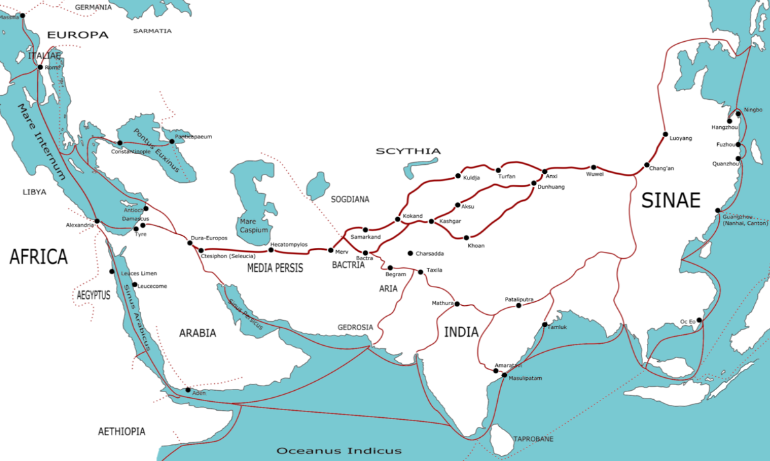
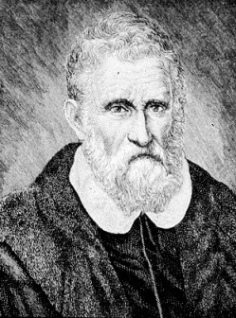
The Silk Road
Marco Polo 1254-1324
6

Slide 7
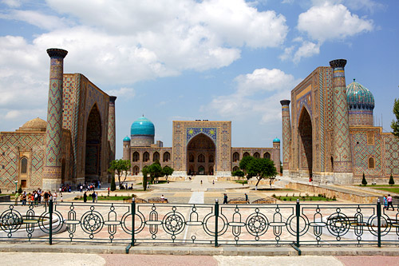
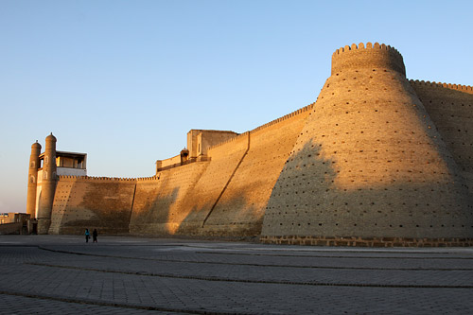
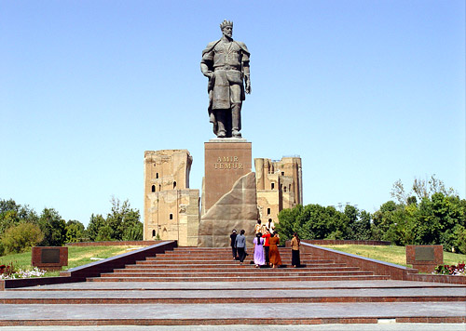
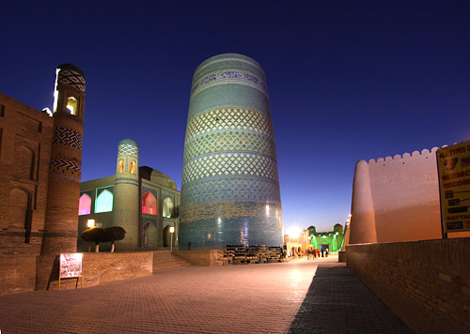
UNESCO World Heritage list Cities
Samarkand
Bukhara
Shakhrisabz
Khiva
TASHKENT
Notes:
7

Slide 8
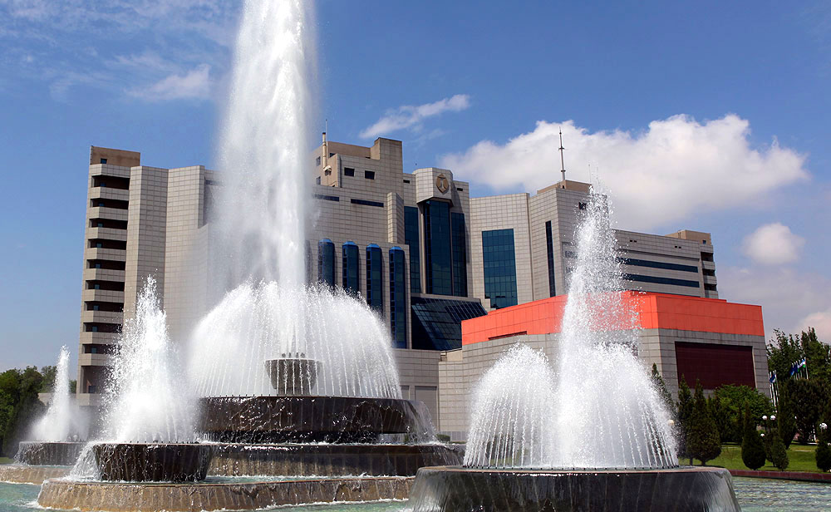
Notes:
8

Slide 9
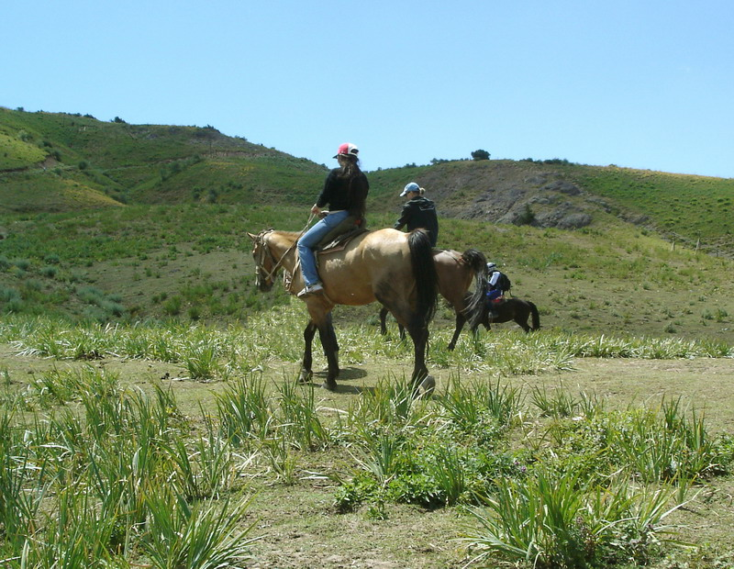
Notes:
9

Slide 10
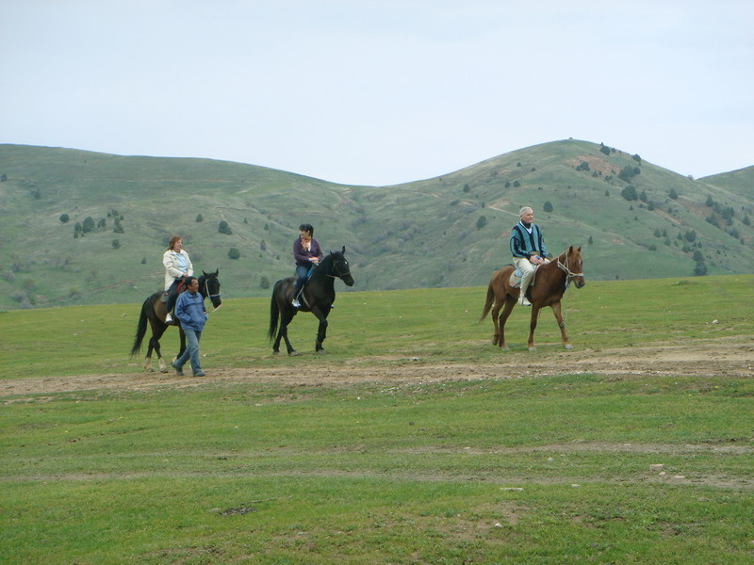
Notes:
10

Slide 11
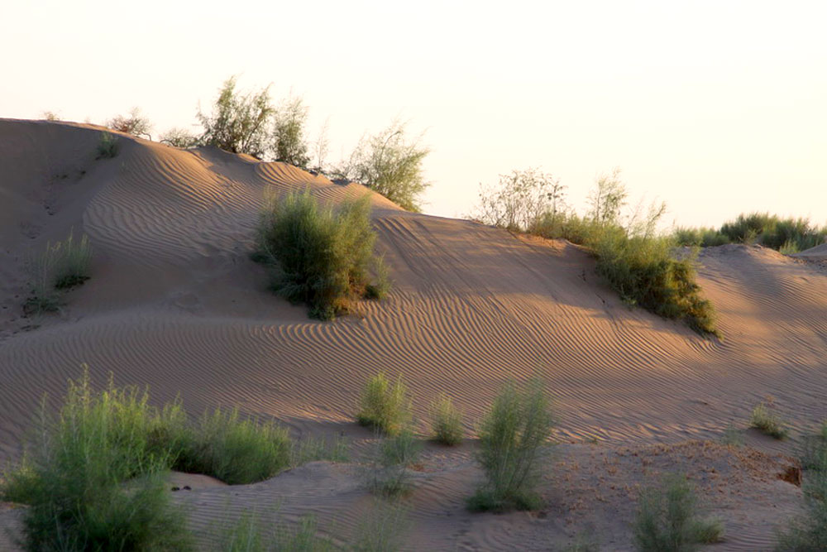
Notes:
11

Slide 12
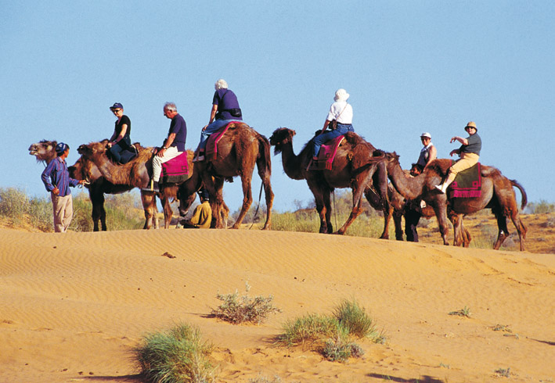
Notes:
12

Slide 13
Notes:
13

Slide 14
Uzbekistan
Rich of raw materials
Population: 31 millions
Political and macroeconomic stability
Automotive production – 280.000 cars/y
Agroindustry development – cotton 3,4 mt
Gas Production 60 BCM/y, export of gas
New industries development
Gas power plants
Innovation, New Technologies
Well educated human resources: Schools/Universities, Torino University
Una finestra sull’Uzbekistan

Slide 15
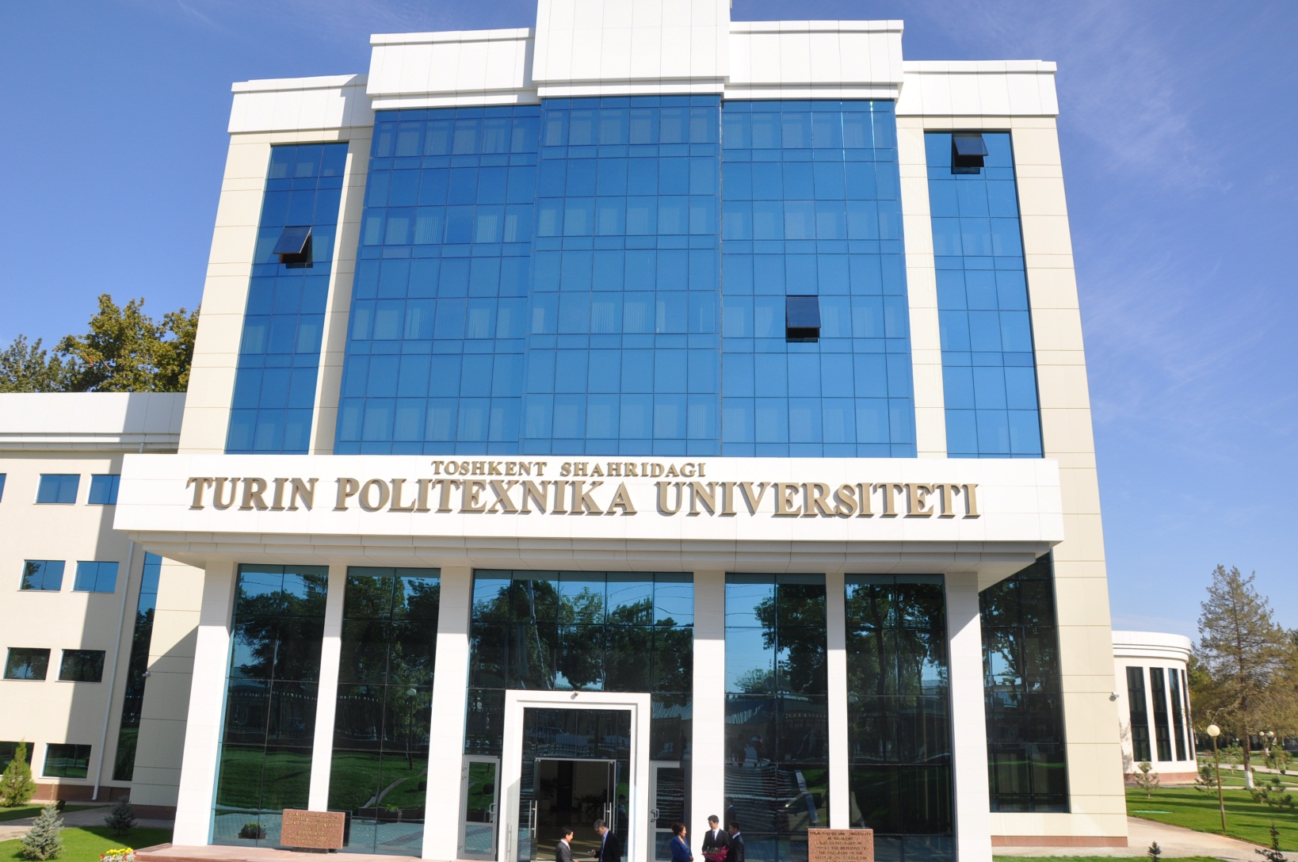
Torino University
Una finestra sull’Uzbekistan

Slide 16
Projects
2. ADB Asian Development Bank highly values its partnership with Uzbekistan, said President Haruhiko Kuroda.
The bank has financed large projects worth over USD 2.4 billion in the country.
At present, it implements a number of major projects in the regions of the country with Uzbekneftegaz.
Recently, an agreement was signed on joint exploration in the Aral Sea region.
3. Project of Construction of Ustyurt Gas Chemical Complex
The project, based of Surgil field, has entered into Top Ten Global Investment Projects of the Year 2012, according to the rating published by Dealogic (Great Britain).
The project was founded by Uzbekneftegaz and an investment consortium of Korean companies KOGAS, Lotte Group and STX Energy. The value of the project is 3,9 BN USD, of which 1,01 BN USD available for 2015.
Una finestra sull’Uzbekistan

Slide 17
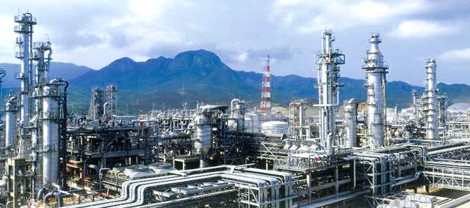
Projects
4. Gas-to-liquids (GTL) project in Uzbekistan. Value: 3.5 bn USD.
The construction contract was awarded to Hyundai. The plant will be located 40 km south of Qarshi.
This plant will be based on Sasol’s GTL technology and will have a capacity of 1.4 million metric tons per year, with following products: GTL diesel, kerosene, naphtha and liquid petroleum gas. The front-end engineering activities was executed by Technip’s operating center in Rome.
Una finestra sull’Uzbekistan

Slide 18
6. Lukoil
Lukoil has been actively involved in major projects in Uzbekistan. The on-going projects entered within the frame of agreements on extraction of gas, gas condensate and oil fields signed in 2004.
Lukoil plans to invest over $ 5 million in two PSA gas projects in Uzbekistan
Kandym-Khauzak-Shady. For Kandym the contract is with the consortium led by Hyundai Engineering. The design capacity will be 8 billion cubic meters of gas per year.
South-West Gissar. Start-up of new facilities is scheduled for beginning of 2017, investments will exceed 1 billion US dollars, gas production is 4.8 bcm annually.
Una finestra sull’Uzbekistan

Slide 19
7. Uzkimyosanoat SJSC and its subdivision Navoiyazot OJS
Project «Construction of polyvinyl chloride, caustic soda and
methanol productions complex» (the annual capacity is 100,000 tonnes of PVC, 75,000 tonnes
of caustic soda, 300,000 tonnes of methanol) at Navoiyazot OJSC.
The construction period will be 2015-2017.
The financing is to be covered by internal funds, as well as attracted credits
of the Fund of Reconstruction and Development of the Republic of Uzbekistan,
foreign and local commercial banks.
Una finestra sull’Uzbekistan

Slide 20
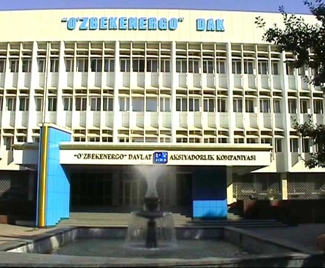
8. UZBEKENERGO
The Power Industry of Uzbekistan operates in the framework of the State Joint Stock Company ”Uzbekenergo”. The company structure includes 53 enterprises and organizations, 39 open joint-stock companies, 11 unitary enterprises, 2 societies with limited liability and company branch “Energosotish”.
As for now, the company performs the centralized electric power supply to national economy and population, and also sale of thermal energy to industrial and domestic consumers.
UZBEKENERGO will invest in 2015 about 600 MIO USD

Slide 21
9. International Exhibition Oil and Gas Uzbekistan-OGU 2015
Opened at the UzExpoCenter National ExpositionCentre.
It is organized by Uzbekneftegaz national holding company, the Ministry of Foreign Economic Relations, Investments and Trade of Uzbekistan, Chamber of Commerce and Industry of the Republic of Uzbekistan. CIUZ attended the 2015 edition with EUSEBI IMPIANTI, SANCO SPA, CANNON, FINDER, FORNOVO GAS, CIMCO
Una finestra sull’Uzbekistan

Slide 22
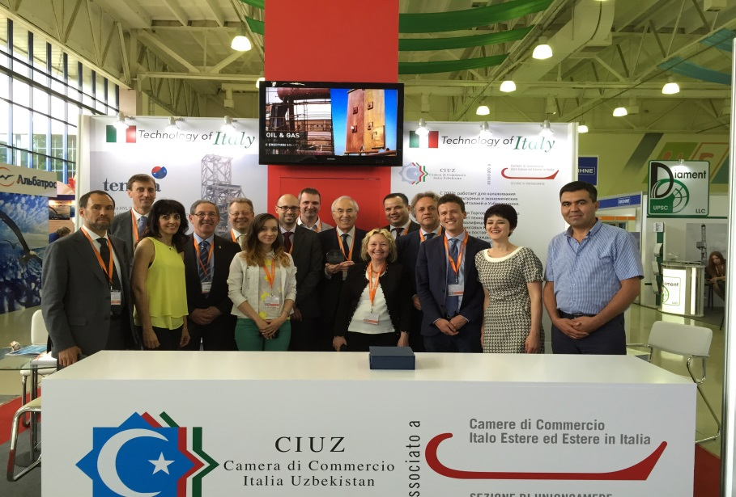
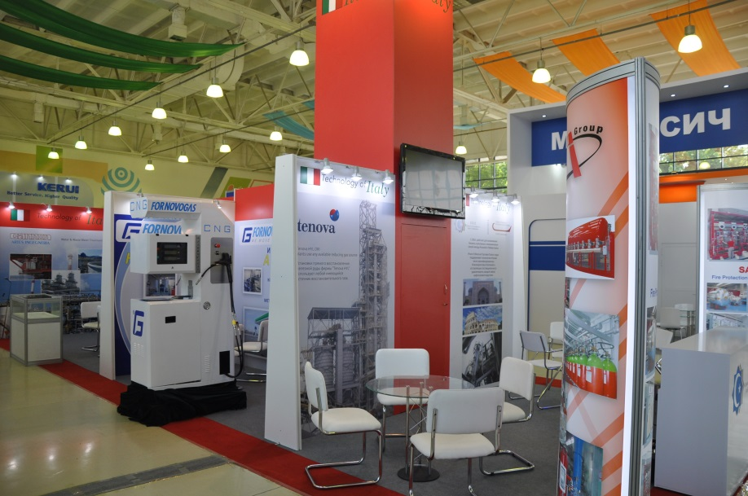
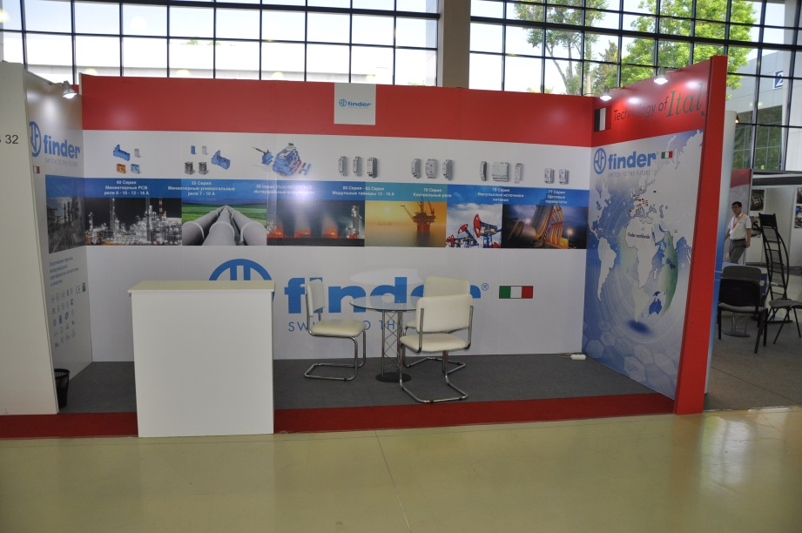
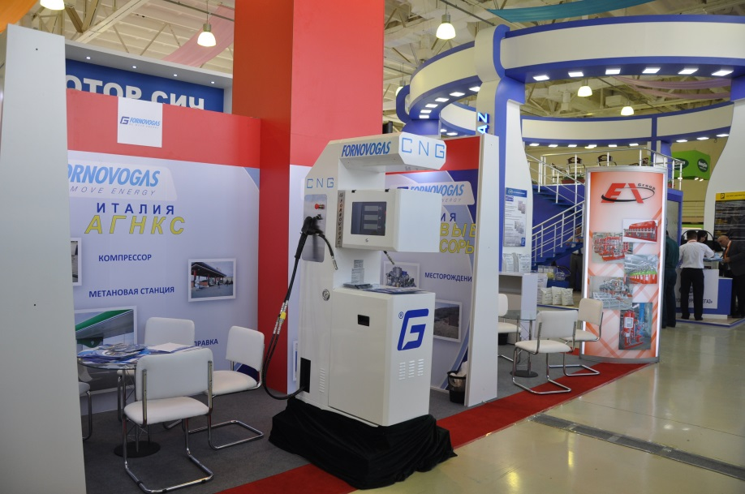
OGU 2015 – Exhibition
Una finestra sull’Uzbekistan

Slide 23
UZBEKISTAN AGROMINITECH EXPO
( 3- 6 June 2015) 10. Edition
Important exposition dedicated to agro industrial machinery and technology for PMI. It is part of the project issued by Uzbek Goverment to support and promote PMI.
Expositors: > 240
Countries: > 30
Visitors: > 40,000
Organized by : Ministry of Foreign Economic Relations, Investments and Trade of Uzbekistan receiving full government support
Una finestra sull’Uzbekistan

Slide 24
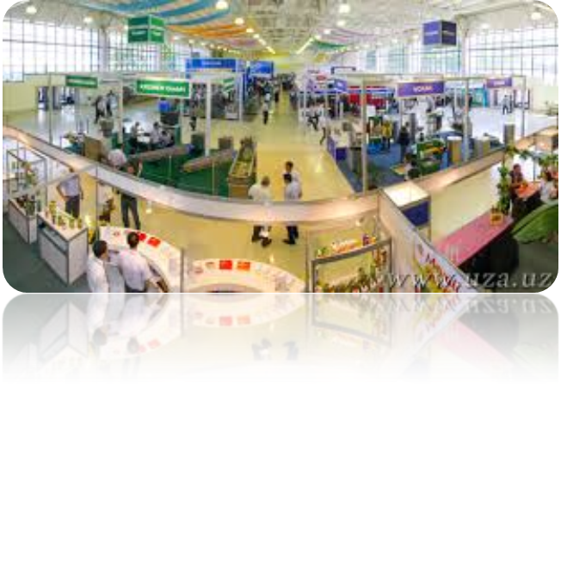
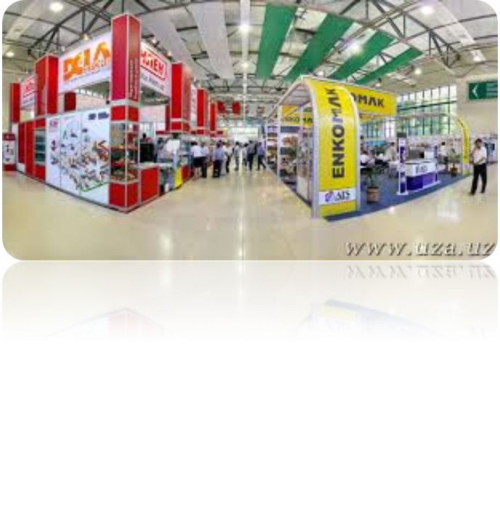
SECTIONS
Processing of fruits and vegetables
Chemicals for plant protection sprayers
Processing of meat and fish
Milk Processing
Manufacture of bakery and pasta
labels, printing, packaging, containers
freezing technologies
Veterinary Medicine
Una finestra sull’Uzbekistan

Slide 25
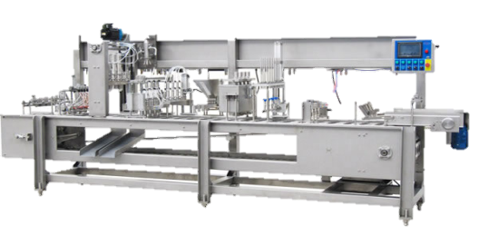
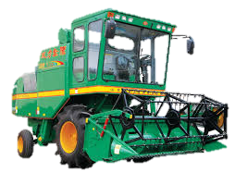
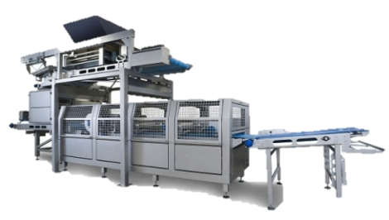
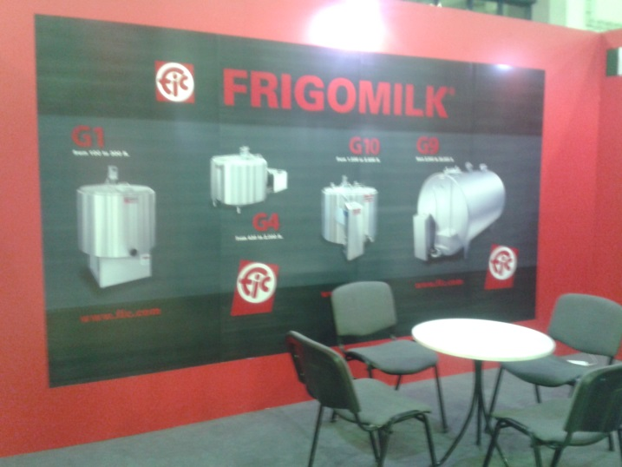
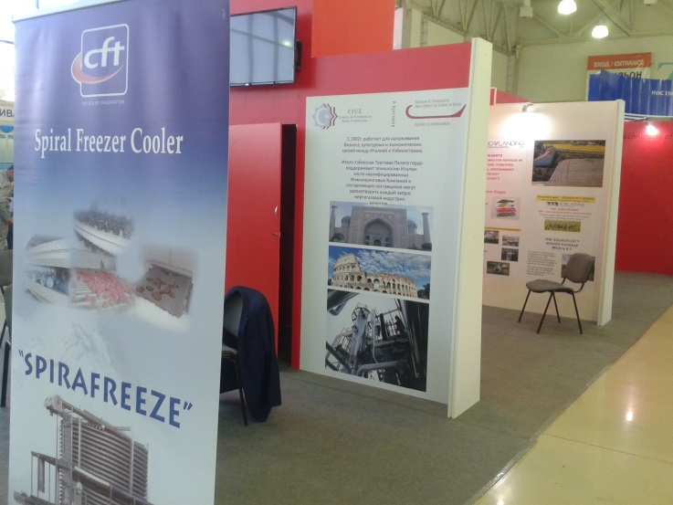
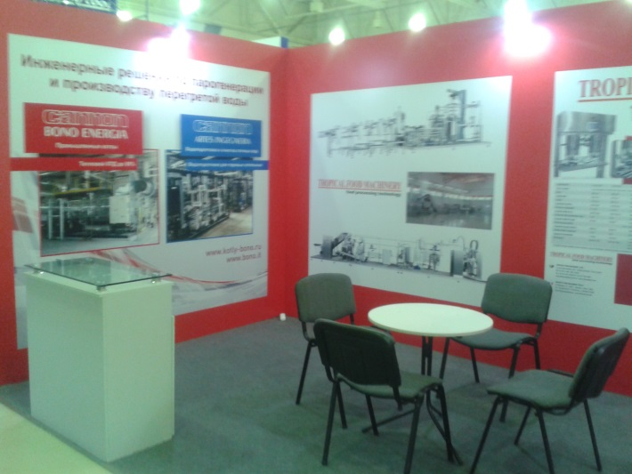
CIUZ attended the exhibition with DELLA TOFFOLA, BERTUZZI FOOD, TROPICAL FOOD, FIC, D&P GROUP, CFT, FINDER E CANNON BONO ENERGIA.

Slide 26
Strong collaboration
Italian
PMI
Uzbek
PMI
Una finestra sull’Uzbekistan

Slide 27
Made In Italy
Shoes
Fashion
Wall papers
Interior design
Taps and fittings
Food
Wine
Una finestra sull’Uzbekistan

Slide 28
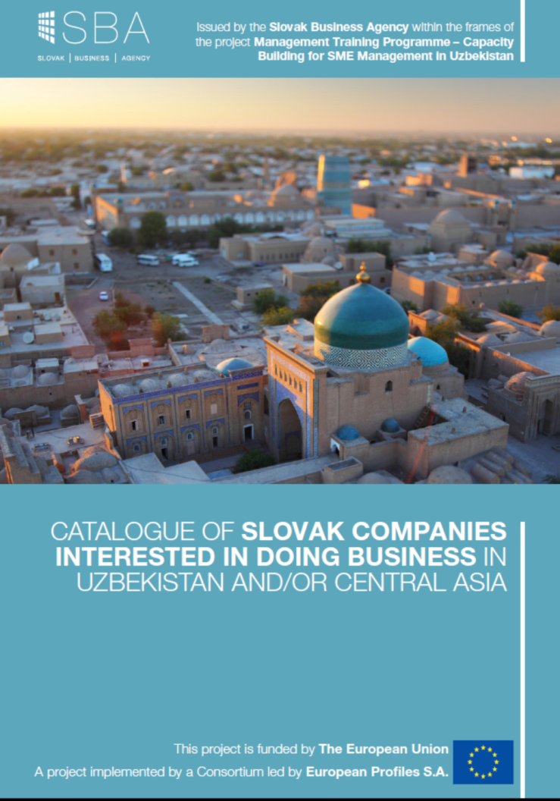
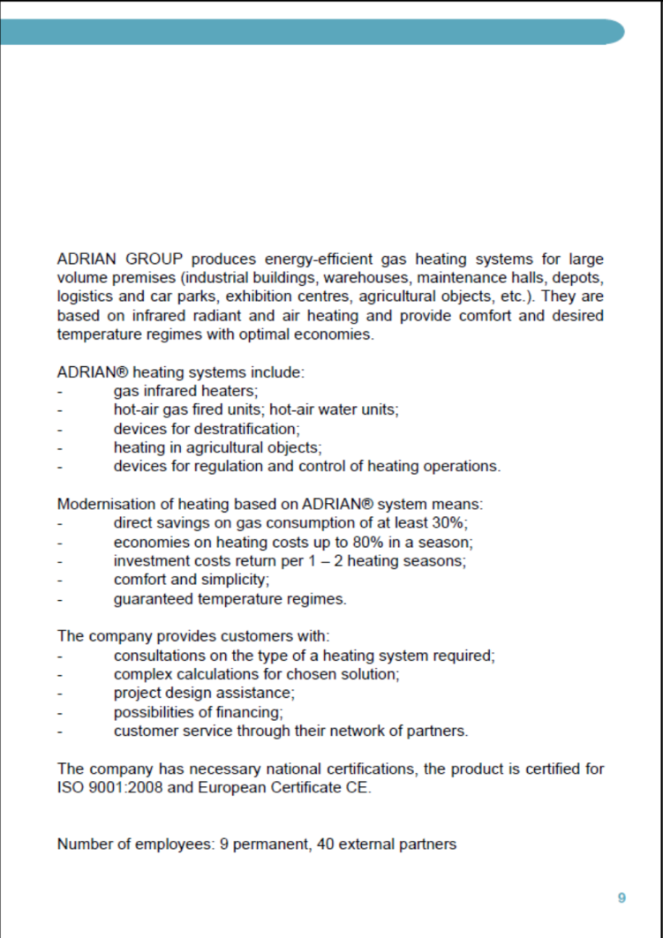
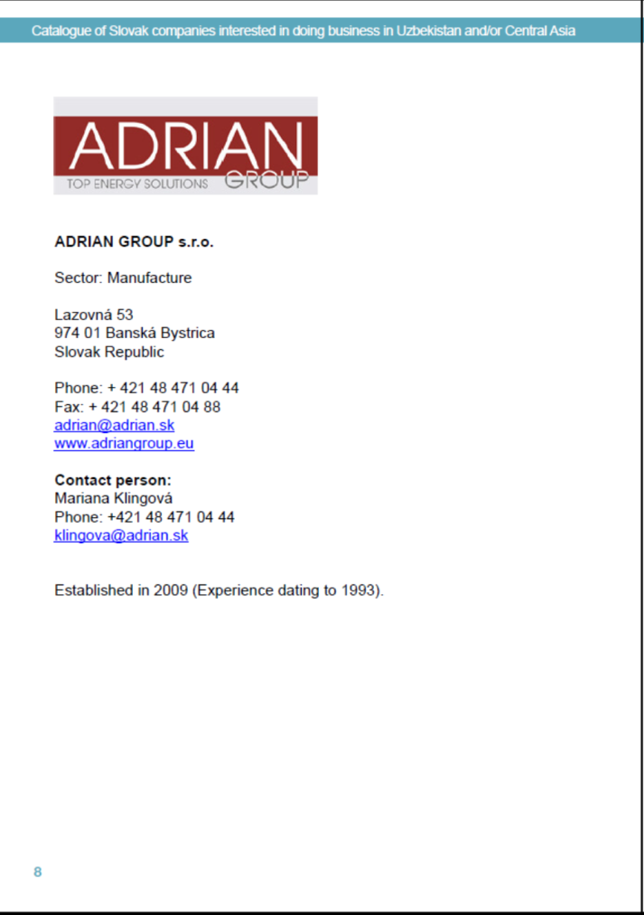

Slide 29
Comitato imprenditoriale dei due paesi
La Camera di Commercio Italia Uzbekistan con uffici a Tashkent ed a Milano.
www.ciuz.info
Tashkent
Mustakillil Av. 75, Off.705
Tel: +998 711401022
ciuz_irgashev@sks.uz
Milano
Via Monte Rosa 93
Tel: +39 0243912773
segreteria@ciuz.info
Una finestra sull’Uzbekistan

Slide 30
Grazie per la cortese attenzione!
Luigi Iperti
Notes:
I have been visiting this Country for many years and every time I come back, I notice just how much it has progressed. Now development has speeded up, along lines which I share. For example, I notice an increasing amount of cooperation with a growing number of other countries including, I am pleased to see Italy which could become very useful partner for the technological and industrial growth of Uzbekistan.
It is the Italy Uzbekistan Chamber of Commerce’s duty to help and promote relations between our two countries. On the basis of the programs of the Uzbek Government, we must ensure the businessperson of both countries to cooperate so these programs are implemented to the best possible way.
Today, we are here for this Conference and we want to explore how our actions can take concrete shape in the gas industry.

